Slide 1

LOAN STATUS PREDICTION USING EXPLORATORY DATA ANALYSIS
TEAM MEMBERS:
M NAVEEN
M ABHIJITH REDDY
K KARTHIK REDDY
SK SHAREEF
M JASWANTH REDDY

Slide 2

INTRODUCTION
Loan Prediction is very helpful for employee of banks as well as for the applicant also.
The aim of this Project is to provide quick, immediate and easy way for bank employees whether the customer can pay back the amount for given interest rate.
Company or bank wants to automate the loan eligibility process (real time) based on customer details provided while filling application form. These details are Gender, Marital Status, Education, Number of Dependents, Income, Loan Amount, Credit History and other.
This study assesses the classification accuracy of an artificial neural network (ANN) model. It examines the application of loan applied customers whether they can repay the amount for the given interest rate.
Loan approval is a very important process for banking organizations. The system approved or reject the loan applications. So, for a bank employee with this application can easily come to a decision whether the applicant is eligible or not.
Recovery of loans is a major contributing parameter in the financial statements of a bank.
It is very difficult to predict the possibility of payment of loan by the customer. Using Artificial Neural Network (ANN) we can predict the loan status of applicant.

Slide 3

AIM The aim of our project is to build a web application to predict find the nature of the client applying for a personal loan.

Slide 4

PROBLEM STATEMENT In India, the number of people applying for loans gets increased for various reasons in recent years. The bank employees are not able to analyze or predict whether the customer can pay back the amount or not (good customer or bad customer) for the given interest rate.

Slide 5

SOLUTION Using Artificial Neural Network Model (ANN) this project is developed. Banks would give loans to only those customers that are eligible so that they can be assured of getting the money back. Hence the more accurate we are in predicting the eligible customers ,it makes easier for bank employees.

Slide 6
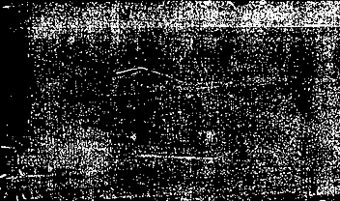

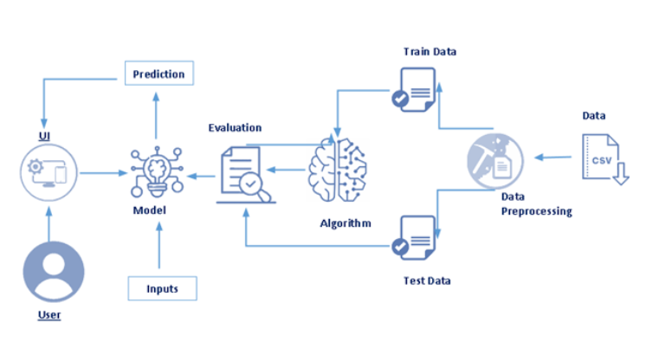

FLOW CHART

Slide 7

PROJECT FLOW STRUCTURE 1) Installing the required packages and libraries.
2) Importing the required libraries for the model to run.
3) Download the dataset,feeding it to the model, and understanding the dataset
4) Data Preprocessing – Checking for outliers and null values. If there any null values we use Label Encoding to convert then into binary format.
5) Dividing the model into Train and Test data. Fitting the model and predicting. 6) Building Flask Web Application

Slide 8

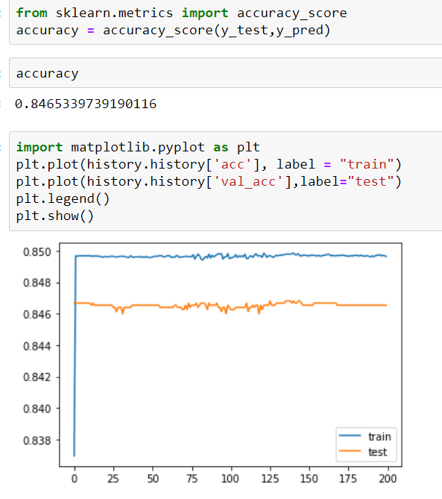
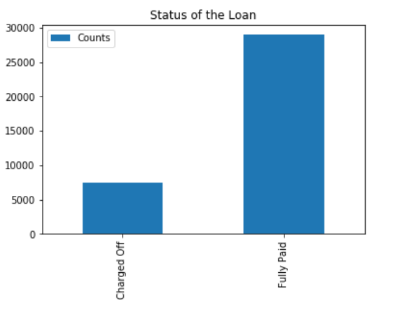
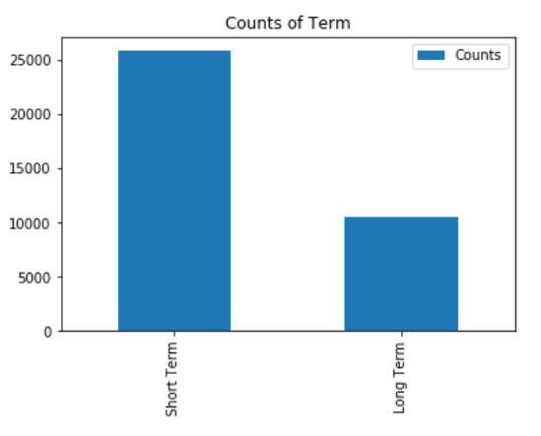
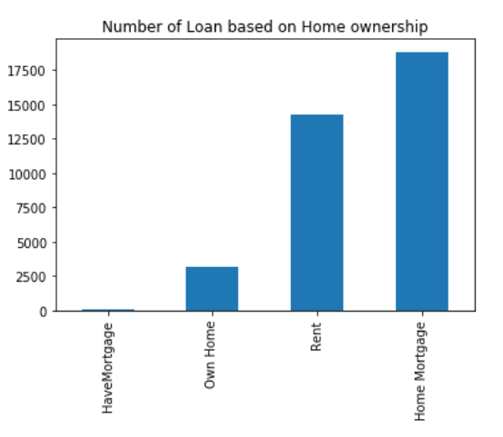
EXPERIMENTAL ANALYSIS

Slide 9
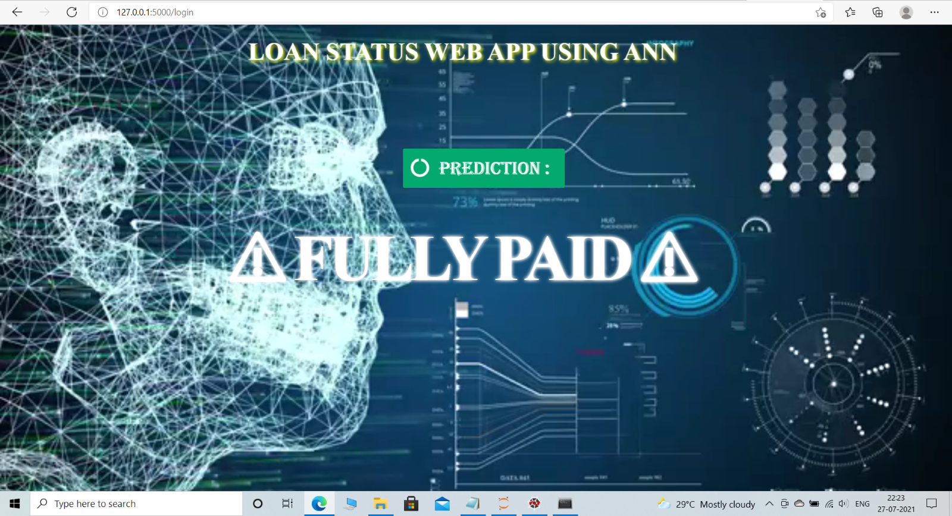
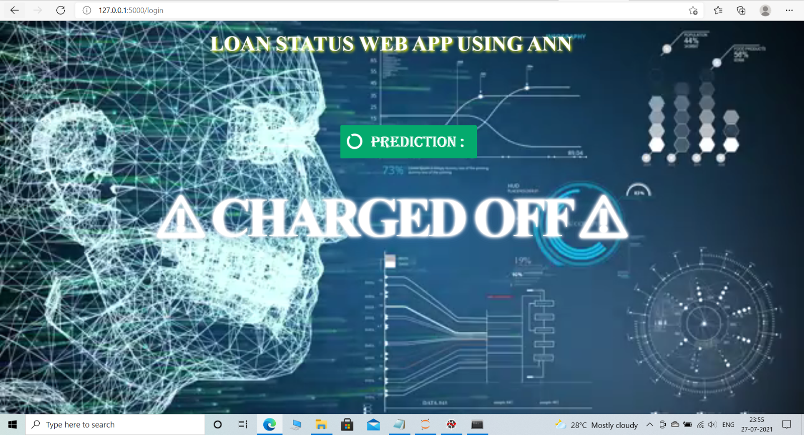
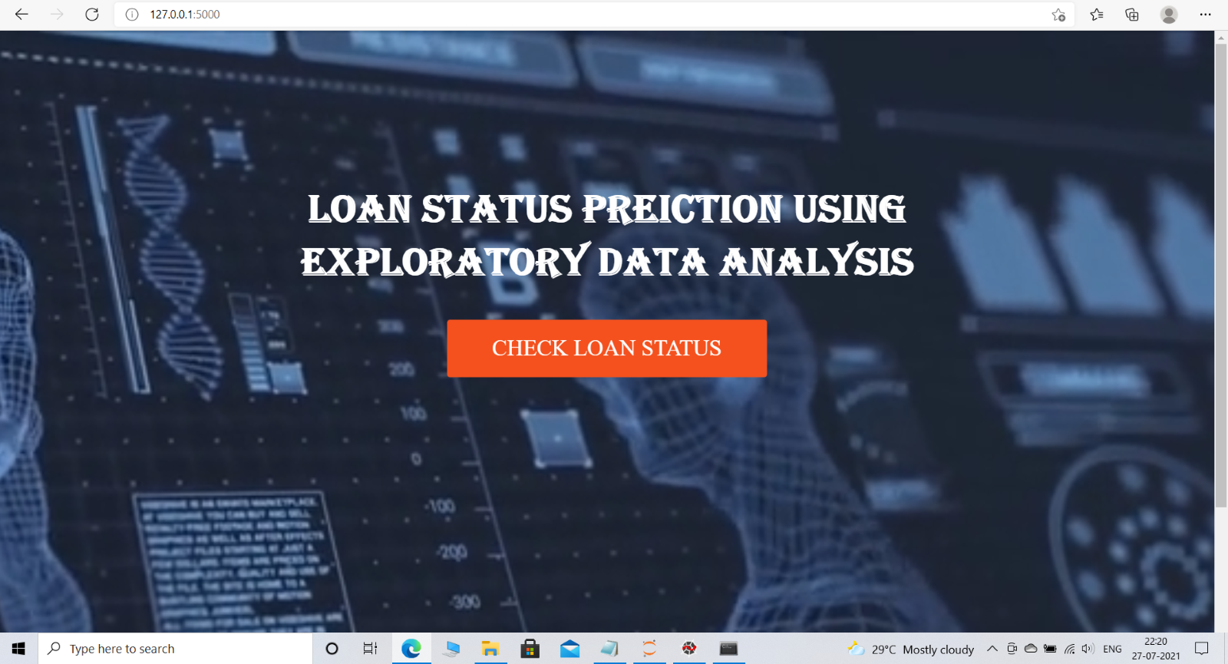
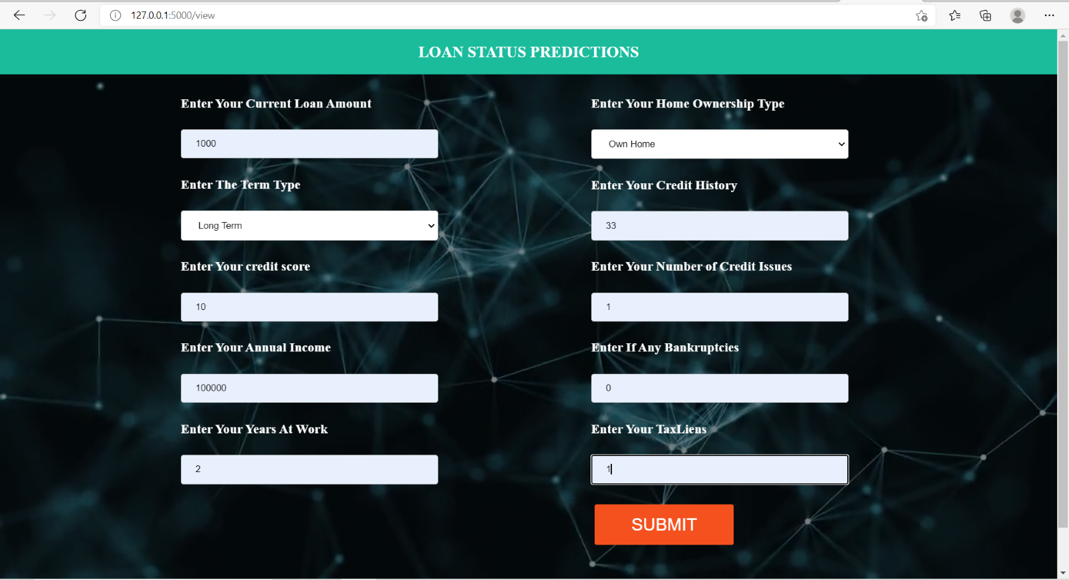
WEB UI DESIGN

Slide 10
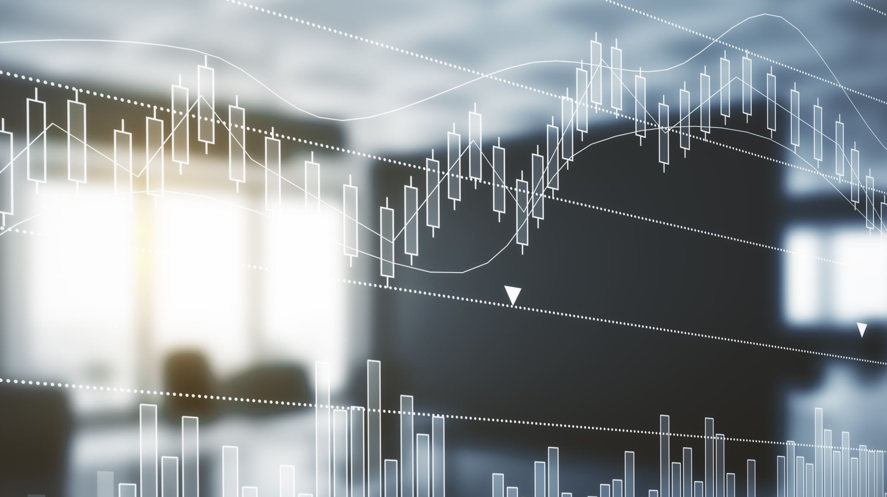
FUTURE WORK This application can be inserted into various applications regarding bank statements.
The UI of the web Application can be developed in variety of ways to look it more attractive
In near future this module of prediction can be integrated with the module of automated processing system.

Slide 11
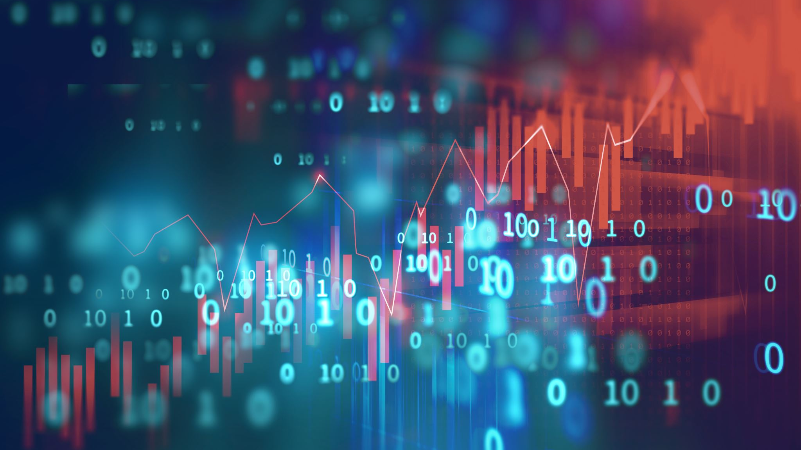
CONCLUSION So here, it can be concluded with confidence that the Artificial Neural Network (ANN) model is extremely efficient and gives a better result and fulfills all requirements of bank employees. It predicts the nature of the client applying for a personal loan.

Slide 12

THANK YOU

